Slide 1
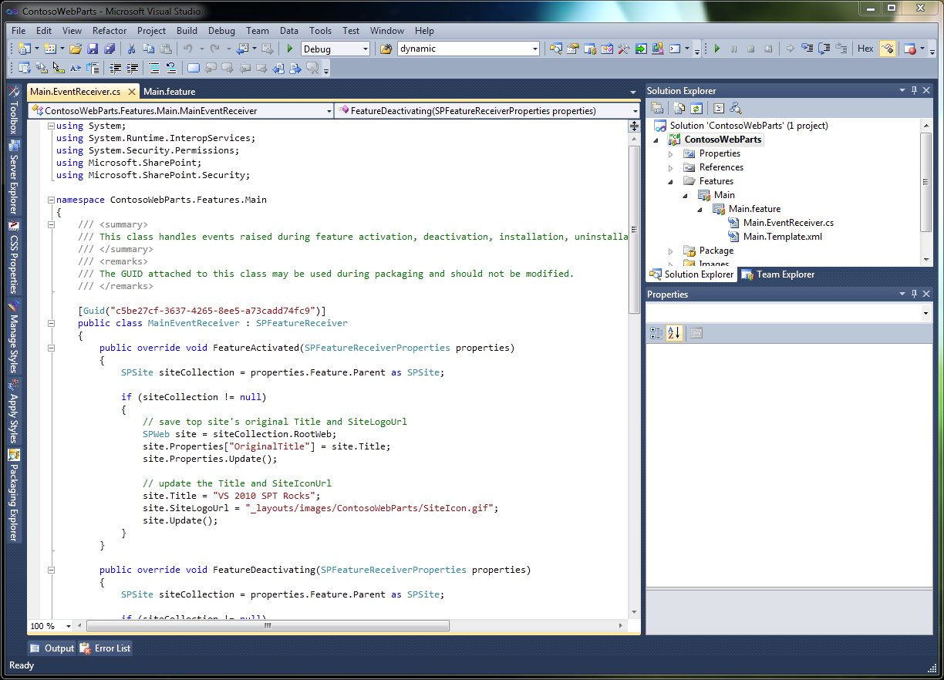
MSDN Presents…
What’s New in Visual Studio 2010
What’s New in .NET 4.0
SharePoint 2010 for Developers

Slide 2
i’m Dave Bost

Slide 3
dbost@microsoft.com

Slide 4

davebost.com

Slide 5


@davebost

Slide 6


http://thirstyDeveloper.com
@thirstyd

Slide 7
get on with it…

Slide 8
What’s New: Visual Studio 2010

Slide 9
Huge List of New Features!
Breakpoint Labeling
Breakpoint Searching
Breakpoint Import/Export
Dynamic Data Tooling
WPF Tree Visualizer
Call Hierarchy
Improved WPF Tooling
Historical Debugging
Mini-Dump Debugging
Quick Search
Better Multi-Monitor Support
Highlight References
Parallel Stacks Window
Parallel Tasks Window
Document Map Margin
Generate From Usage
Concurrency Profiler
Inline Call Tree
Extensible Test Runner
MVC Tooling
Web Deploy
JQuery Intellisense
SharePoint Tooling
HTML Snippets
Web.config Transformation
Click-Once Enhancements for Microsoft Office

Slide 10
Overview
General Improvements
Debugging
Parallelism
Web
Extensibility

Slide 11
General Improvements

Slide 12
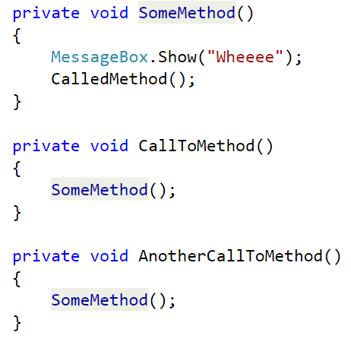
Highlighting References
CTRL+SHIFT+ DOWN ARROW (forward) CTRL+SHIFT+ UP ARROW (reverse)
Automatic highlighting of a symbol
Can be used with declarations, references, and many other symbols

Slide 13
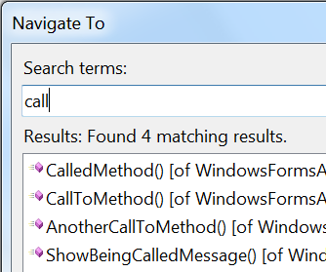
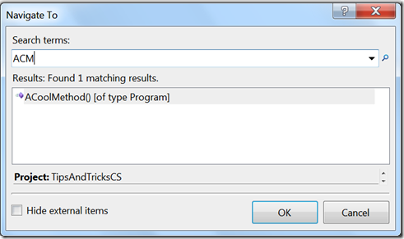
Navigate To
CTRL + ,
Provides search-as-you-type support for symbols
Enables quick searching based on case usage

Slide 14
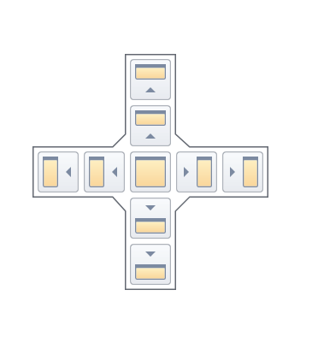
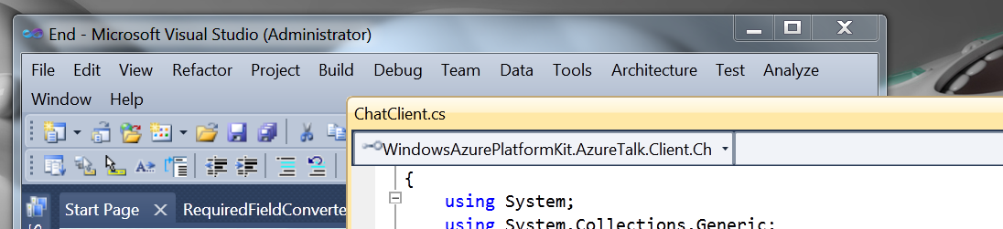
Docking Windows
New Guide Diamond
Windows can be docked anywhere
Can now pull document windows outside the IDE

Slide 15
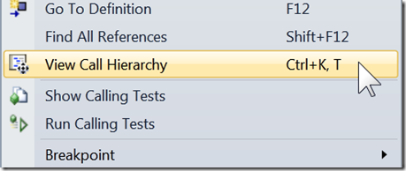
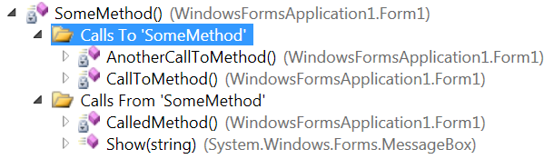
Call Hierarchy (C# only)
CTRL + K, T
Used to see calls to and from a method
Great way to see calls at design time

Slide 16
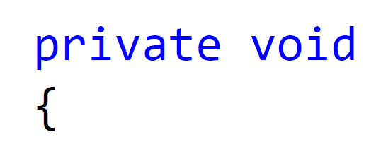


Zoom
CTRL + Mouse Wheel
New feature that enhances the size of your code
Very useful for pair programming (or similar scenarios)

Slide 17
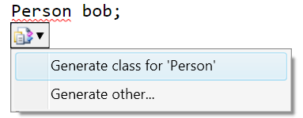
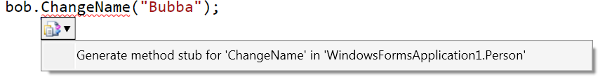
Generate from Usage
Used to automatically create stub code
Enables you to use classes and members before you define them

Slide 18
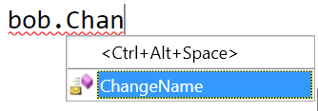
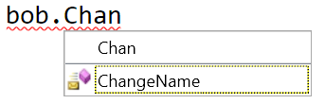
Intellisense Suggestion Mode
CTRL + ALT + SPACE
Used when classes and members are used before they are defined
Helps to reduce situations where IntelliSense inserts unintended text into the editor

Slide 19


General Improvements

Slide 20
Debugging

Slide 21
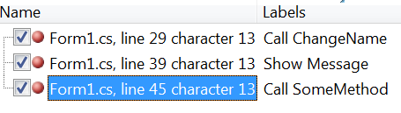


Breakpoints
Can add labels to breakpoints
All breakpoints are now searchable
Import / Export now available

Slide 22
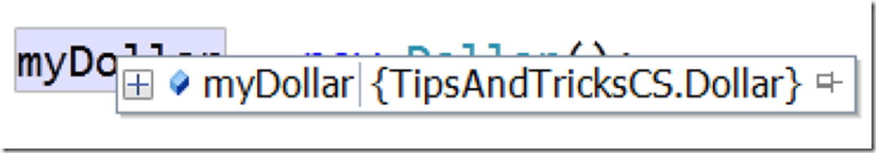
Floating Data Tips

Slide 23
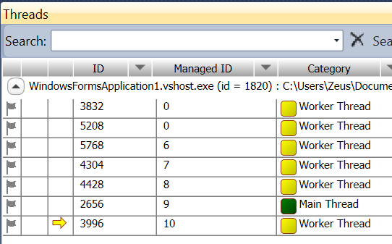
Threading
Completely redesigned threading window
Now provides filtering, call-stack searching and expansion, and grouping
New columns added:
Affinity masks
Process names
Managed IDs

Slide 24

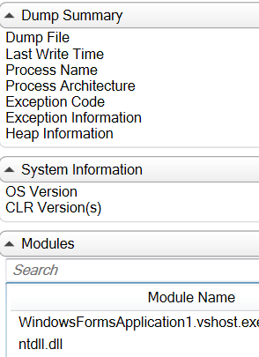
Dumps
You can save a dump file and debug it later, either on the build computer or on another computer that has the source files and debugging symbols
Can read dump files that contain information about managed code, unmanaged code, or a mixture of both

Slide 25
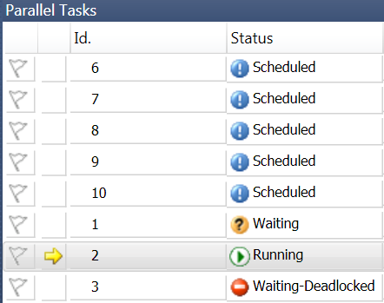
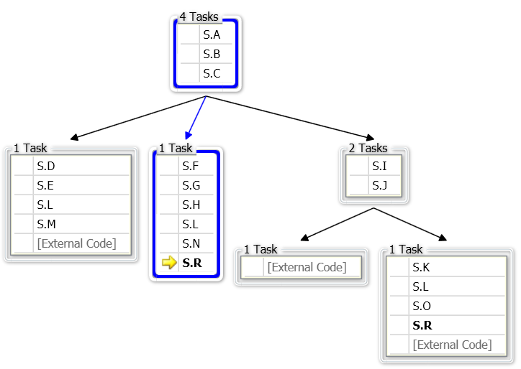
Parallel Tasks and Stacks
Used to visualize and debug parallel code that is written in C++, C#, or Visual Basic
Using the Parallel Stacks window, you can view multiple call stacks at the same time in a single view
Parallel Tasks allow you to see multiple tasks and the corresponding status of those tasks

Slide 26
Debugging

Slide 27
Web

Slide 28
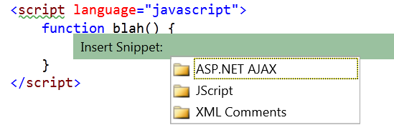
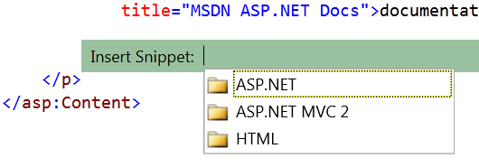
Code Snippets
Snippets are now available in web applications
Two major contextual areas:
JavaScript
HTML

Slide 29
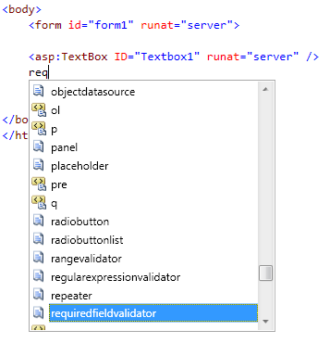
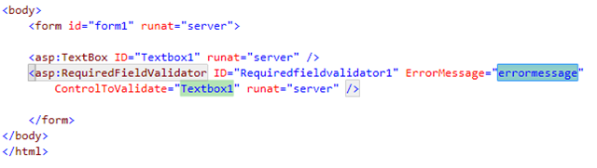
Code Snippets

Slide 30
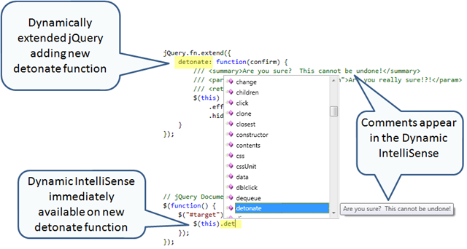
Dyanmic Intellisense for JavaScript

Slide 31
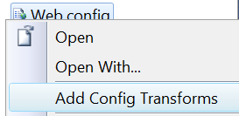
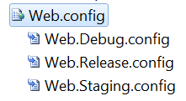
Web.config Transforms
You can create configuration file transforms to modify your project's Web.config file to work with various deployment environments
http://blogs.msdn.com/webdevtools

Slide 32

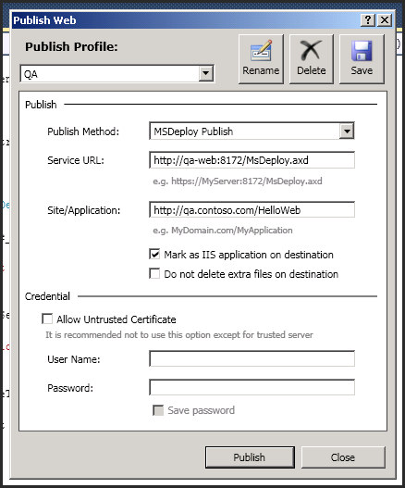
One-Click Web Deployment
With Visual Studio 2010, MSDeploy is integrated directly into Visual Studio
Once you have your profiles configured, you can easily deploy to a given environment with a single click

Slide 33
Web

Slide 34
Extensibility

Slide 35
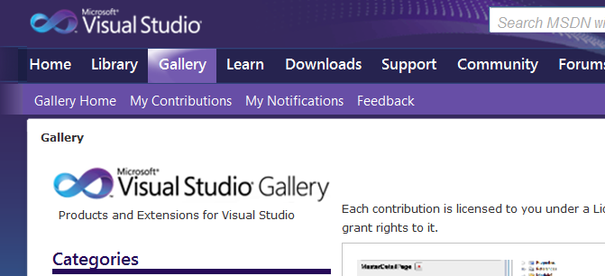
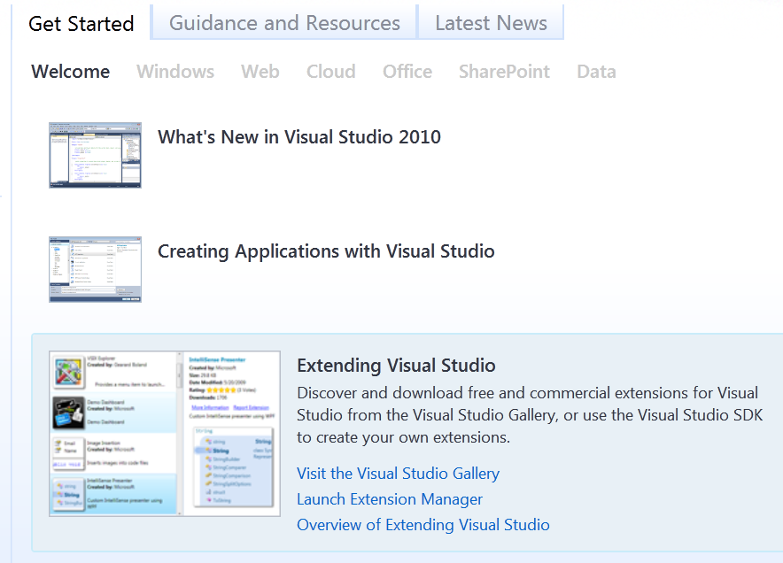
The Visual Studio Gallery
http://visualstudiogallery.msdn.microsoft.com

Slide 36
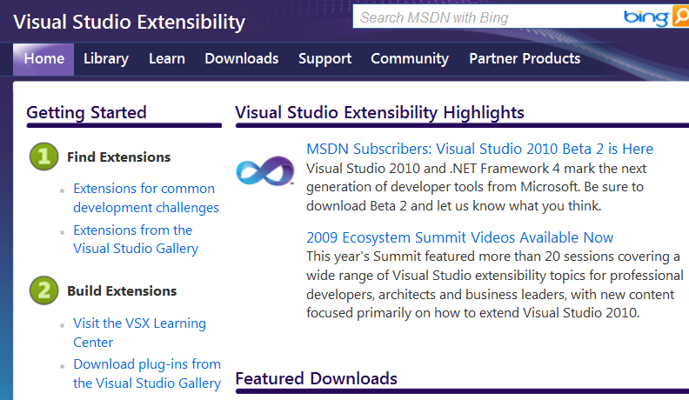
Making Your Extensions
http://msdn.microsoft.com/en-us/vsx/default.aspx

Slide 37
Extensions

Slide 38
Resources
What’s New in Visual Studio 2010 http://msdn.microsoft.com/en-us/library/bb386063(VS.100).aspx
Visual Studio on MSDN http://msdn.microsoft.com/vstudio
Visual Studio 2010 Tips and Tricks http://blogs.msdn.com/zainnab

Slide 39
15 Minute Break

Slide 40
What’s New in the .NET Framework 4.0

Slide 41
From There to Here…
SP1
3.5
3.0
.NET 1.0
.NET 1.1
.NET 2.0
.NET 4
2002
2003
2005-08
2008 CTP!
CLR 1.0
CLR 1.1
CLR 2.0
CLR 4

Slide 42
.NET Framework Architecture
WPF
Win Forms
DLR
ASP.NET
WCF
LINQ
And more!
Base Class Libraries
Common Language Runtime
JIT & NGEN
Garbage Collector
Security Model
Exception Handling
Loader & Binder

Slide 43
Overview
Client Profile
Visualization
Data
Programming Languages
Common Language Runtime (CLR)
Base Class Libraries (BCL)
Web

Slide 44
Client Profile

Slide 45
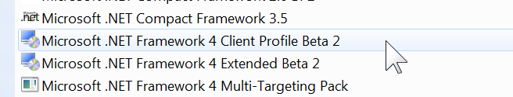

Client Profile
Subset of the full .NET Framework
Leveraged for faster deployments
Two Sections
Client Profile
Extended
Streamlined pieces of
Windows Presentation Foundation (WPF)
Windows Forms
Windows Communication Foundation (WCF)
ClickOnce

Slide 46
Visualization

Slide 47
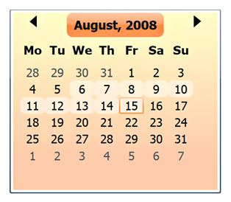
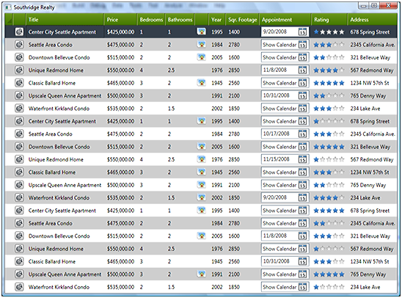
Windows Presentation Foundation (WPF)
New Controls
DataGrid
Calendar
DatePicker
Visual State Manager
Touch and Manipulation
Text

Slide 48
Calendar and DatePicker Controsl

Slide 49
Data

Slide 50
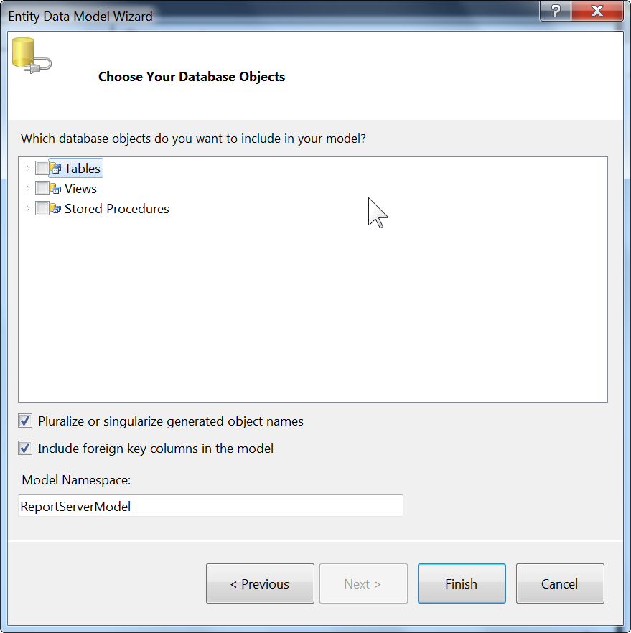
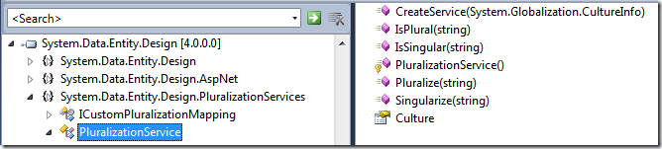
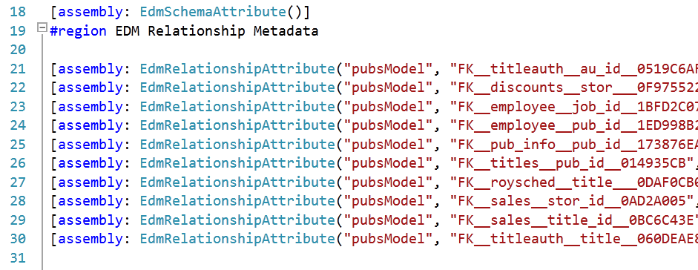
Pluralization & Foreign Keys

Slide 51
Model-First
Existing
Database
Database
First (v1)
Generated
Entity Data
Model
Generated
Database
Model
First (v2)
Entity Data
Model

Slide 52
Model-First

Slide 53
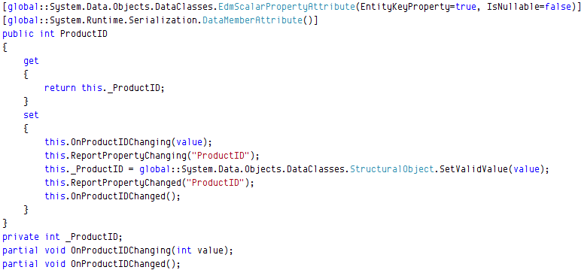
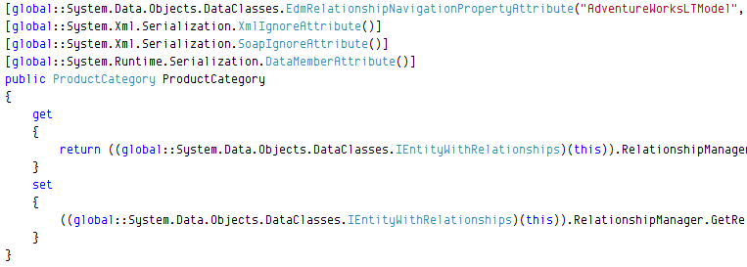
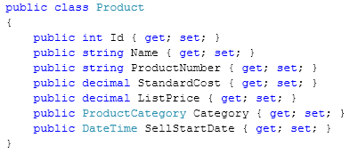

POCO
Class Definition
Everything
Navigation Property Definition
Scalar Property Definition

Slide 54
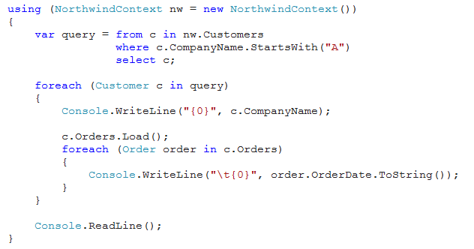
Deferred / Lazy Loading
Explicit
Deferred / lazy

Slide 55
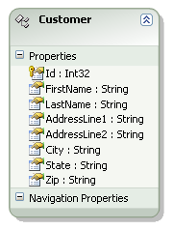
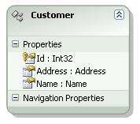
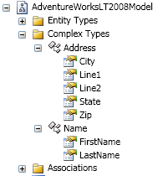
Complex Types
VS.

Slide 56
Programming Languages

Slide 57

Visual Basic
Auto-Implemented Properties
Shortened syntax that enables you to quickly specify a property of a class without having to write code
Collection Initializer
Shortened syntax that enables you to create a collection and populate it with an initial set of values
Implicit Line Continuation
Enables you to continue a statement on the next consecutive line without using the underscore character
Public Property Owner As String = "DefaultName"
Function AddStuff(
ByVal first As Integer,
ByVal second As Integer
) As Integer
Return first +
second
End Function
Public Property Items As New List(Of String) = {“M“, “T“, “W“}

Slide 58

C#
Dynamic Type
Operations that contain expressions of type dynamic are not resolved or type checked by the compiler. The compiler packages together information about the operation, and that information is later used to evaluate the operation at run time
Optional and Named Parameters
Named arguments enable you to specify an argument for a particular parameter by associating the argument with the parameter's name rather than with the parameter's position in the parameter list.
Optional arguments enable you to omit arguments for some parameters. Both techniques can be used with methods, indexers, constructors, and delegates.

Slide 59
C#: - dynamic keyword - named and optional parameters

Slide 60

F#
IDE support for F#
Interactive F# for prototyping code
Asynchronous constructs
Parallel constructs
Immutable data types

Slide 61
Common Language Runtime (CLR)

Slide 62

Existing Side-By-Side (SxS)
1.1 add-in
2.0 add-in
3.0 add-in
3.5 add-in
3.5
.NET 1.1
3.0
.NET 2.0
Host Process (i.e. Outlook)

Slide 63
In-Process Side-By-Side (SxS)
2.0 add-in
3.0 add-in
3.5 add-in
4.0 add-in
3.5
.NET 4.0
3.0
.NET 2.0
Host Process (i.e. Outlook)

Slide 64
Base Class Libraries (BCL)

Slide 65
Task Parallel Library (TPL)
Set of public types and APIs
System.Threading
System.Threading.Tasks
// Sequential
foreach (var item in sourceCollection)
{
Process(item);
}
// Parallel
Parallel.ForEach (sourceCollection, item => Process(item));

Slide 66
New Sync Primitives in .NET 4
Thread-safe, scalable collections
IProducerConsumerCollection<T>
ConcurrentQueue<T>
ConcurrentStack<T>
ConcurrentBag<T>
ConcurrentDictionary<TKey,TValue>
Phases and work exchange
Barrier
BlockingCollection<T>
CountdownEvent
Partitioning
{Orderable}Partitioner<T>
Partitioner.Create
Exception handling
AggregateException
Initialization
Lazy<T>
LazyInitializer.EnsureInitialized<T>
ThreadLocal<T>
Locks
ManualResetEventSlim
SemaphoreSlim
SpinLock
SpinWait
Cancellation
CancellationToken{Source}
ManyCore: http://microoftpdc.com/Sessions/P09-09 (50:00)

Slide 67
Parallelize For Loops
Control flow is a primary source of work
Parallelizable when iterations are (or can be made) independent
Synchronous
All work quiesces, regularly or exceptionally
Lots of knobs
Cancelation, breaking, task-local state, custom partitioning, scheduling, degree of parallelism
for (int i = 0; i < n; i++)
{
work(i);
}
foreach(var item in data)
{
work(item);
}
StatementA();
StatementB;
StatementC();
Parallel.For(0, n, i=>
{
work(i);
});
Parallel.ForEach(data, item=>
{
work(item);
});
Parallel.Invoke(
() => StatementA(),
() => StatementB,
() => StatementC());
ManyCore: http://microsoftpdc.com/Sessions/P09-09

Slide 68
Parallel LINQ (PLINQ)
Implements the full set of LINQ standard query operators
Extension methods for the IParallelEnumerable interface
Additional operators for parallel operations
from n in names.AsParallel().WithDegreeOfParallelism(ProcessorsToUse.Value)
where n.Name.Equals(queryInfo.Name, StringComparison.InvariantCultureIgnoreCase) &&
n.State == queryInfo.State &&
n.Year >= yearStart && n.Year <= yearEnd
orderby n.Year ascending
select n;

Slide 69
Parallelism

Slide 70
Design By Contract
System.Diagnostics.Contracts
Code Contracts introduce a way to specify contractual information that is not represented by a method or type’s signature alone
Scenarios for using contracts include:
Perform static bug finding, which enables some bugs to be found without executing the code
Create guidance for automated testing tools to enhance test coverage
Create a standard notation for code behavior, which provides more information for documentation
public Boolean ExampleMethod(String parameter) { if (parameter == null) throw new ArgumentNullException ("parameter must be non-null"); }
http://msdn.microsoft.com/devlabs

Slide 71
Data Types
BigInteger
Immutable type that represents an arbitrarily large integer whose value in theory has no upper or lower bounds
SortedSet<T>
Provides a self-balancing tree that maintains data in sorted order after insertions, deletions, and searches

Slide 72
I/O
Memory-Mapped File
Used to edit very large files and to create shared memory for inter-process communication
Stream.CopyTo
Allows you to copy the contents of one stream into another

Slide 73
Web

Slide 74
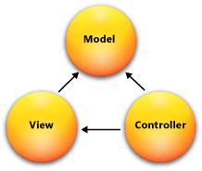
Model-View-Controller (MVC)
Huge investment from Microsoft
Alternative to WebForms
Modular Architecture
MVC 2.0 Integrated in .NET Framework 4.0

Slide 75
ASP.NET Webforms
Ability to set meta tags
More control over view state
Added and Updated browser definition files
ASP.NET Routing
The ability to persist selected rows in data controls
More control over rendered HTML in the FormView and ListView controls
Filtering support for data source controls

Slide 76
Dynamic Data
A RAD experience for quickly building a data-driven Web site
Automatic validation that is based on constraints defined in the data model
The ability to easily change the markup that is generated for fields in the GridView and DetailsView controls by using field templates

Slide 77
Web

Slide 78
Resources
.NET Developer Center http://msdn.microsoft.com/net
Data Developer Center http://msdn.microsoft.com/data
Concurrency (Parallelism) http://msdn.microsoft.com/concurrency
ASP.NET MVC http://asp.net/mvc
WPF and Windows Forms http://windowsclient.net

Slide 79
15 Minute Break

Slide 80
SharePoint Development with Visual Studio 2010

Slide 81
SharePoint 2010 Enhancements
New object model
LINQ for SharePoint
Native support for Silverlight
Sandboxed Solutions
External data lists

Slide 82
Overview
SharePoint Projects
Event Receivers
Deployment & Debugging
Web Parts

Slide 83
SharePoint Projects

Slide 84
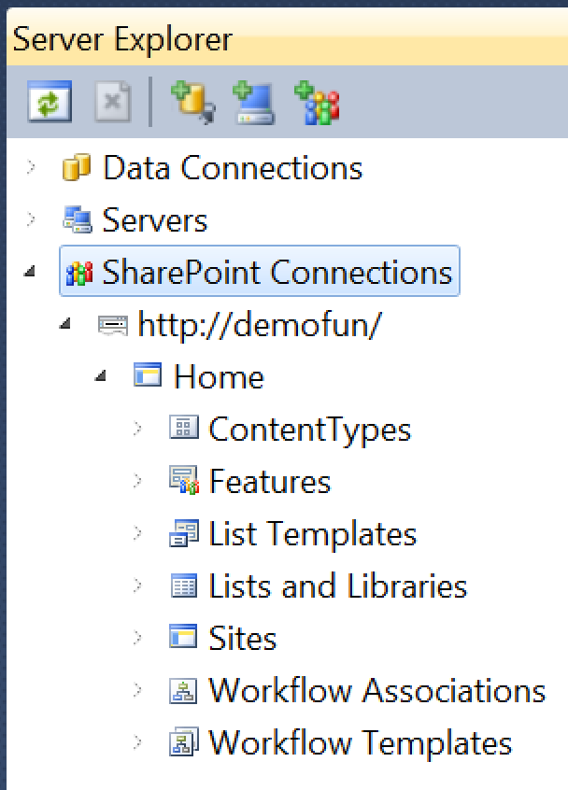
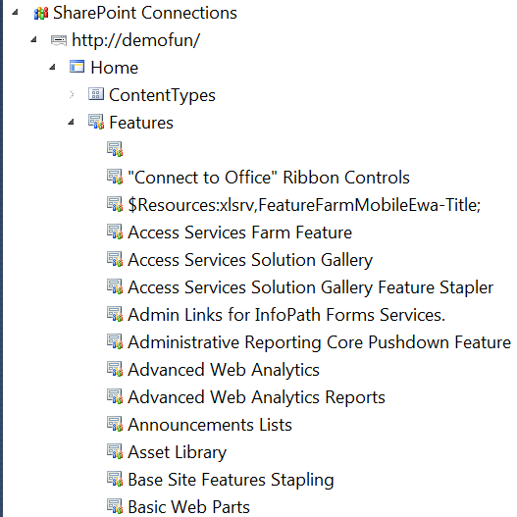
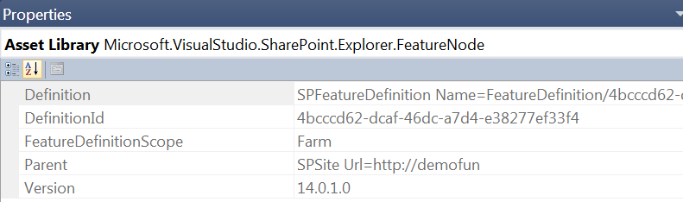
Server Explorer

Slide 85
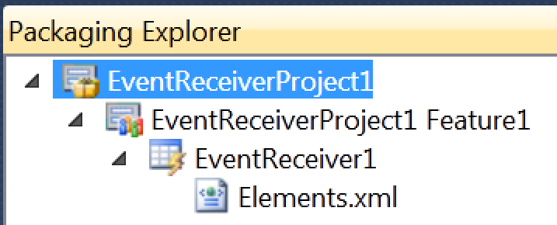
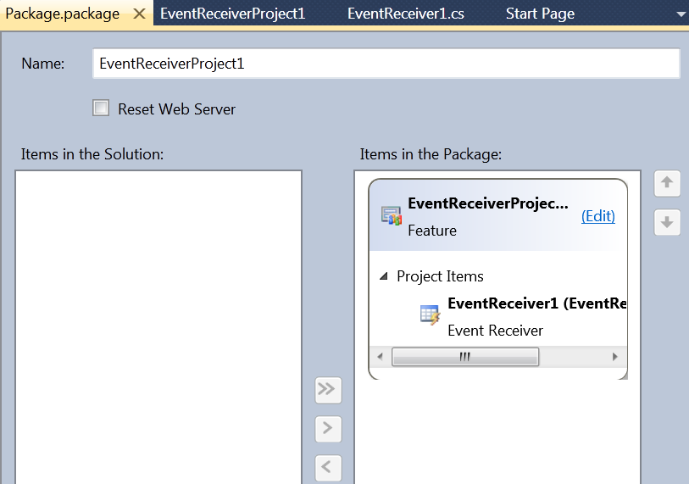
Packages

Slide 86
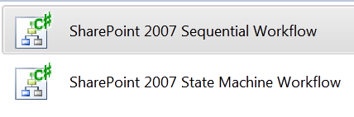

SharePoint Projects
Then
now

Slide 87

Empty Project

Slide 88
SharePoint Projects

Slide 89
Event Receivers

Slide 90



Event Receivers

Slide 91

Creating Event Receivers

Slide 92
Event Receivers

Slide 93
Deployment & Debugging

Slide 94

Deployment: Project Creation

Slide 95

Properties: SharePoint Tab

Slide 96


Deployment

Slide 97

Debugging

Slide 98
Deployment & Debugging

Slide 99
Web Parts

Slide 100



Visual Web Part

Slide 101


Web Part

Slide 102
Web Parts

Slide 103
Resources
Learn SharePoint 2010 on Channel 9 http://channel9.msdn.com/learn/courses/SharePoint2010Developer/
SharePoint 2010 Developer Center http://msdn.microsoft.com/SharePoint

Slide 104
Dave Bost
dbost@microsoft.com
@davebost
http://davebost.com
http://ThirstyDeveloper.com

Slide 105

© 2008 Microsoft Corporation. All rights reserved. Microsoft, Windows, Windows Vista and other product names are or may be registered trademarks and/or trademarks in the U.S. and/or other countries.
The information herein is for informational purposes only and represents the current view of Microsoft Corporation as of the date of this presentation. Because Microsoft must respond to changing market conditions, it should not be interpreted to be a commitment on the part of Microsoft, and Microsoft cannot guarantee the accuracy of any information provided after the date of this presentation. MICROSOFT MAKES NO WARRANTIES, EXPRESS, IMPLIED OR STATUTORY, AS TO THE INFORMATION IN THIS PRESENTATION.

